Slide 1

FINAL PROJECT PRESENTATION
THE BEAUTIFUL GAME.
YOUR FANTASY TEAM.
TASHKEELA
OMAN FOOTBALL MANAGER
FIFA-style fantasy football for the Oman Professional League
TEAM 1 • Almonther • Mohammed • Rashid • Salima • Salwa
TEAM 1 / OMAN PROFESSIONAL LEAGUE
01

Slide 2
OMAN AI FOOTBALL MANAGER
Why this project?
!
THE GAP
+
THE OPPORTUNITY
★
THE SOLUTION
Local football fans have limited fantasy experiences focused on Omani clubs.
Bring match statistics, player discovery and fantasy competition into one platform.
A dedicated Oman Professional League fantasy manager with ratings and advice.
TEAM 1 / OMAN PROFESSIONAL LEAGUE
02

Slide 3
OMAN AI FOOTBALL MANAGER
Project objectives
01
SECURE ACCESS
02
BUILD YOUR XI
03
EARN POINTS
User accounts, JWT and role-based access
Select 11 players within a budget
Match performances drive scoring
04
COMPETE
05
ANALYZE
06
ADMIN CONTROL
Compare fantasy teams on a leaderboard
Player ratings and fantasy recommendations
Manage clubs, players and match data
TEAM 1 / OMAN PROFESSIONAL LEAGUE
03

Slide 4
OMAN AI FOOTBALL MANAGER
Technology lineup
FRONTEND
BACKEND
HTML5 • CSS3 • JavaScript
Java 17 • Spring Boot 3.5.5
DATABASE
SECURITY
MariaDB • MySQL Workbench
Spring Security • JWT
APIs
PLAYER ANALYSIS
RESTful endpoints
Java-based statistical algorithms
TEAM 1 / OMAN PROFESSIONAL LEAGUE
04

Slide 5
OMAN AI FOOTBALL MANAGER
How the system works
01
02
03
04
→
→
→
BROWSER
HTML / CSS / JS
REST API
Spring Controllers
BUSINESS LOGIC
Services / Security
DATABASE
MariaDB
User interactions flow through protected APIs and application services before data is stored.
TEAM 1 / OMAN PROFESSIONAL LEAGUE
05

Slide 6
OMAN AI FOOTBALL MANAGER
Matchday starts with your XI
01 Browse
Explore clubs, players, prices and ratings
02 Select
Build an 11-player team within budget
03 Captain
Choose the player with 2× points
04 Track
View fantasy points and rankings
TEAM 1 / OMAN PROFESSIONAL LEAGUE
06

Slide 7
OMAN AI FOOTBALL MANAGER
The admin control room
✓
CLUBS
✓
PLAYERS
Create and maintain club records
Update profiles, positions and prices
✓
MATCHES
✓
STATISTICS
Record fixtures, results and performances
Enter match data used by scoring
TEAM 1 / OMAN PROFESSIONAL LEAGUE
07

Slide 8
OMAN AI FOOTBALL MANAGER
Every action earns points
GOAL
ASSIST
CLEAN SHEET
TEAM WIN
+5
+3
+4
+2
MAN OF THE MATCH
AI RATING ≥ 8.0
YELLOW CARD
RED CARD
+5
+3
−1
−3
CAPTAIN = 2× TOTAL POINTS
TEAM 1 / OMAN PROFESSIONAL LEAGUE
08

Slide 9
OMAN AI FOOTBALL MANAGER
Player intelligence
★
↗
⌁
PLAYER RATINGS
FANTASY ADVICE
DEVELOPMENT
Performance-based FIFA-style ratings help users compare footballers.
Recommendations support smarter team choices using player statistics.
Rating history can help show how players perform over time.
Note: Spring AI framework integration is not confirmed in the inspected source.
TEAM 1 / OMAN PROFESSIONAL LEAGUE
09

Slide 10
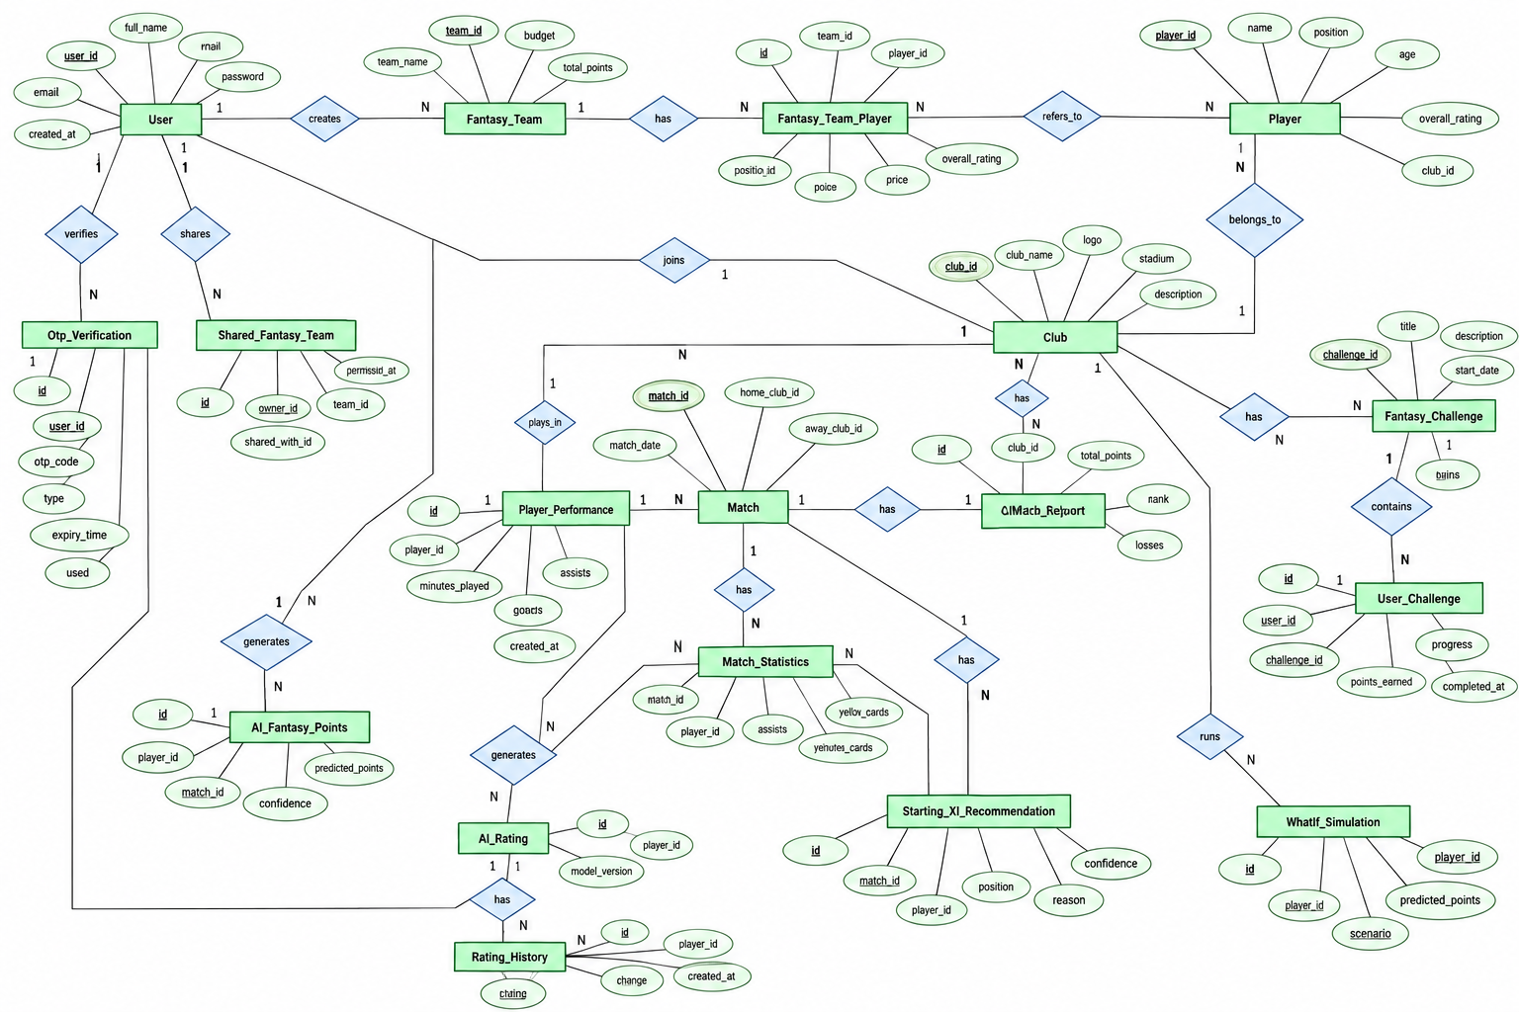
OMAN AI FOOTBALL MANAGER
ERD | Core relationships
USER
FANTASY TEAM
TEAM PLAYER
PLAYER
MATCH
PERFORMANCE
CLUB
Conceptual relationship overview — confirm final keys and cardinalities against JPA entities.
TEAM 1 / OMAN PROFESSIONAL LEAGUE
10

Slide 11
OMAN AI FOOTBALL MANAGER
Database at the heart of the game
IDENTITY
FOOTBALL
Users and authentication
Clubs, players and matches
FANTASY
PERFORMANCE
Teams, selections and points
Player match statistics
TEAM 1 / OMAN PROFESSIONAL LEAGUE
11

Slide 12
OMAN AI FOOTBALL MANAGER
Team 1 | Five contributors
01
Almonther Alwaili
Contribution to be confirmed
02
Mohammed Alhamrashdi
Contribution to be confirmed
03
Rashid Alshibli
Contribution to be confirmed
04
Salima Alsaidi
Contribution to be confirmed
05
Salwa Al Zuhibi
Contribution to be confirmed
TEAM 1 / OMAN PROFESSIONAL LEAGUE
12

Slide 13
OMAN AI FOOTBALL MANAGER
Quality checks before kickoff
LOGIN & ROLES
FANTASY RULES
✓
✓
Test user/admin access boundaries
Validate budget, 11-player limit and captain
SCORING
AI & API
✓
✓
Confirm every scoring rule and leaderboard update
Check endpoints and fallback behavior
DATABASE
SECURITY
✓
✓
Run with a clean MariaDB setup
Rotate exposed SMTP password and review CORS
TEAM 1 / OMAN PROFESSIONAL LEAGUE
13

Slide 14
OMAN AI FOOTBALL MANAGER
Live demo | The match plan
01
02
03
LOG IN
EXPLORE
BUILD XI
User authentication
Players and clubs
Budget and captain
04
05
06
SCORE
ANALYZE
ADMIN
Points and leaderboard
Ratings and advice
Manage match statistics
TEAM 1 / OMAN PROFESSIONAL LEAGUE
14

Slide 15
TEAM 1 / SPEAKER FLOW / Mohammed
Mohammed Alhamrashdi
Security, authentication & platform
01 Start the application
02 Register and verify
Introduce TASHKEELA and the full-stack architecture
Show registration, OTP email and verification
03 Log in securely
04 Share a fantasy team
Explain Spring Security, JWT and protected routes
Demonstrate team-sharing link and common UI
SHOW IN DEMO: login.html • register.html • verify.html • index.html
HANDOFF → SALWA

Slide 16
TEAM 1 / SPEAKER FLOW / Salwa
Salwa Al Zuhibi
Clubs, admin dashboard & challenges
01 Browse Omani clubs
02 Enter admin area
Show club information and club dashboard
Explain admin management and access controls
03 Manage club data
04 Explore extras
Show create/edit operations with prepared records
Describe weekly challenges, badges and What-If simulation
SHOW IN DEMO: clubs.html • admin.html
HANDOFF → SALIMA

Slide 17
TEAM 1 / SPEAKER FLOW / Salima
Salima Alsaidi
Users, players & player intelligence
01 Explore player directory
02 Explain user roles
Show positions, clubs and player profiles
Describe user records and role handling
03 Compare players
04 Show AI analysis
Show player comparison and available attributes
Explain ratings and analysis as implemented
SHOW IN DEMO: players.html • ai.html • dashboard.html
HANDOFF → RASHID

Slide 18
TEAM 1 / SPEAKER FLOW / Rashid
Rashid Alshibli
Matches, performance & match AI
01 Browse match schedule
02 Enter match statistics
Show match list and fixture details
Explain match data and player performances
03 Show AI match report
04 Explain Starting XI
Demonstrate available report generation
Show recommended lineup functionality
SHOW IN DEMO: matches.html • match statistics • AI match report
HANDOFF → ALMONTHER

Slide 19
TEAM 1 / SPEAKER FLOW / TEAM CONCLUSION
Almonther Alwaili
Fantasy teams, scoring & ratings
01 Build a fantasy XI
02 Choose captain
Select 11 players within the available budget
Explain captain selection and double points
03 Calculate points
04 Check leaderboard
Walk through goal, assist, card and AI bonus rules
Show standings, AI ratings and rating history
SHOW IN DEMO: my-team.html • leaderboard.html
HANDOFF → TEAM CONCLUSION

Slide 20

OMAN AI FOOTBALL MANAGER
Full time. The future starts here.
BUILT FOR
OMANI FOOTBALL
Fantasy teams • Data-driven points
Player analysis • Local competition
THANK YOU / QUESTIONS?
TEAM 1 / OMAN PROFESSIONAL LEAGUE
15

